Slide 1

Interview

Slide 2


Pre Interview
Conduct Research
Company profile, product, Background and history
Study about job responsibilities and requirements
Where to get information about company?
Company’s Website
Network
Job Posting Agency

Slide 3






Review Common Questions& Responses What are the common question?
Self- Introduction
Why are you interested in this role?
Why do you think you should be hired?
What do you think about the industry you apply for?
What’s your career goal?
What are your strengths and weaknesses?

Slide 4


What are the common question?
What is your expectation ?

Slide 5


Dress for Success
Arrive on Time & Well Prepare

Slide 6
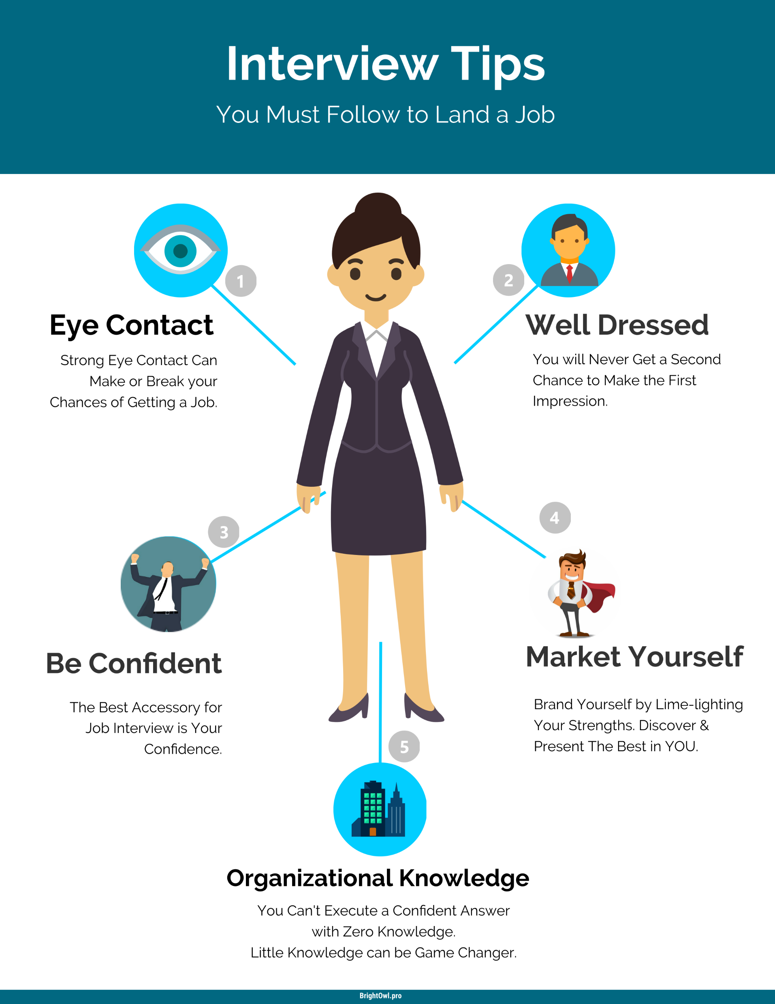
During Interview

Slide 7
What can you do if you don’t understand the question during the interviewer?

Slide 8

Answer
Ask interviewer to repeat question
Ask for Clarification
Ask for explanation

Slide 9
What can you do if you understand the question but you don’t know the answer?

Slide 10
Answer
Response: That’s an interesting question! I might not be able to give the best answer but let me try.
Totally Don’t Know???
Sorry, I haven’t done enough homework on this point.
Let me try your other questions.

Slide 11




Post Interview
Ask Questions to Interviewer at the end of conversation
When could I know the result?
How would the company inform me about the result?
Thank Interviewer
In Person
Email
Phone Call

Slide 12


